Slide 1

Recursion
By Georgi Stoimenov

Slide 2


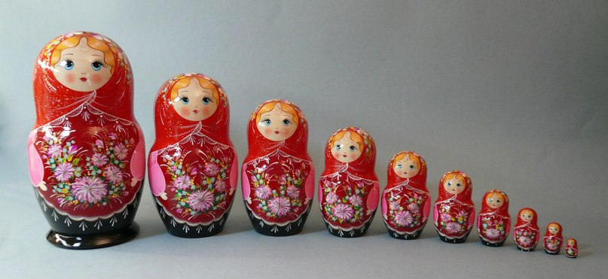
What is actually a recursion?

Slide 3

Recursion in programming is…

Slide 4

The Fibonacci sequence - Demo
Click me!

Slide 5

How it works?
Fib(4)
Fib(3)
Fib(2)
Fib(2)
Fib(1)
Fib(0)
Fib(1)
Fib(0)

Slide 6



Specifics of the recursion
Bottom
Depth
Directions

Slide 7

Modified Fibonacci
private static long GetModifiedFibonacci(int n)
{
if (n <= 2)
{
return 1;
}
long result = 5;
result += GetModifiedFibonacci(n - 1) + GetModifiedFibonacci(n - 2);
result = result * n;
return result;
}
Straight move
Bottom
Backward move

Slide 8

Recursion types
Indirect
Direct

Slide 9

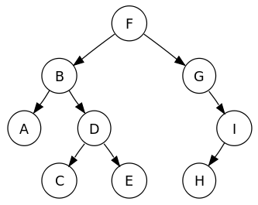
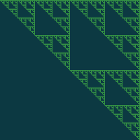

Recursive algorithms
Find path in labyrinth
Tree traversal
Click me!

Slide 10

What is the idea behind Recursion?

Slide 11

Is recursion always applicable?
Notes:
It's usually slower due to the overhead of maintaining the stack.
May require more memory (because of stack).
When using big data or even bad algorithm
can cause StackOverflow Exception.

Slide 12

Conclusion
Notes:
Using recursion makes your code simple and understandable. It can be used to solve difficult tasks with ease.
However stepping out the boundary can make your algorithm slow and uneffective.

Slide 13

Thanks for the attention!
Insert link here.

